Slide 1
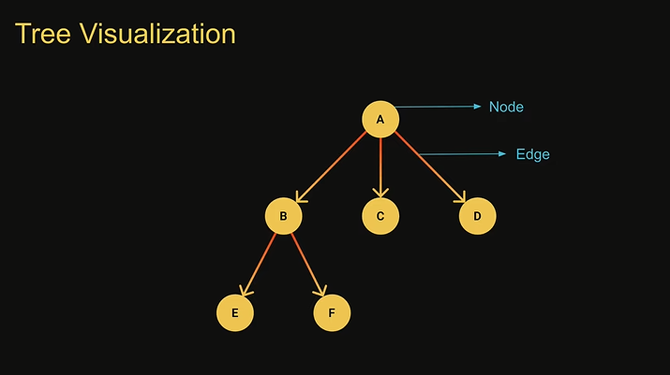
Tree
A tree is an hierarchical data structure that consists of nodes connected by edges
A tree is a non- linear data structure, compared to arrays, linked lists, stacks and queues which are linear data structure
In linear data structures the time required to search is proportional to the size of the data set.
Trees however owing to the nonlinear nature allow quicker easier access to the data
A tree will not contain any loops or cycles
Tree Usage
File System for directory structure
A family Tree
An organization tree
DOM
Chat Bots
Abstract syntax trees

Slide 2
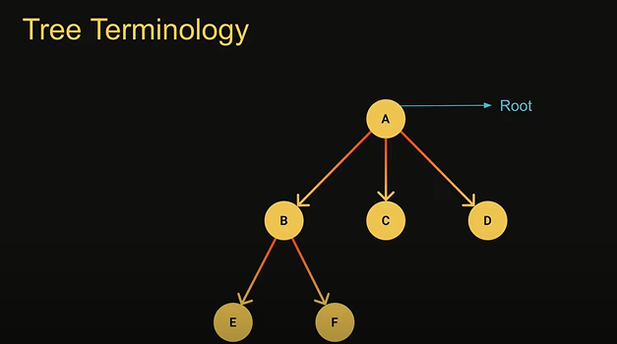
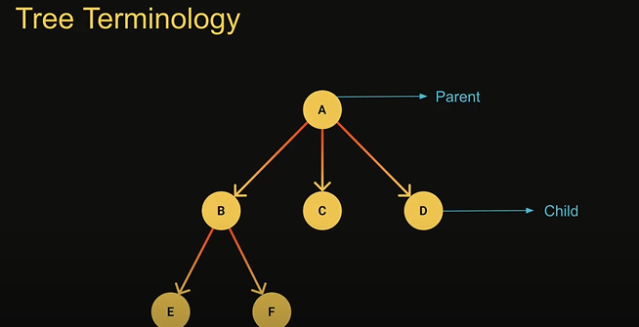
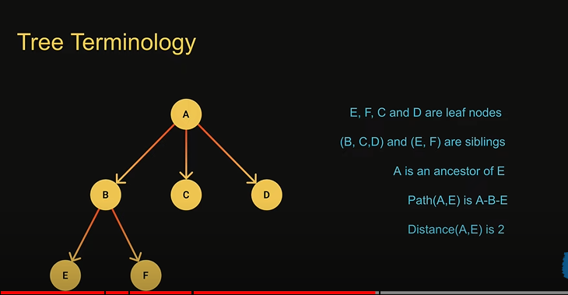
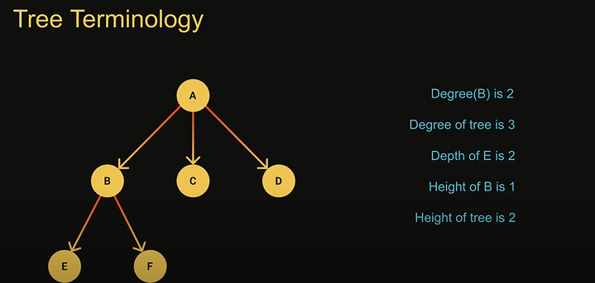

Slide 3
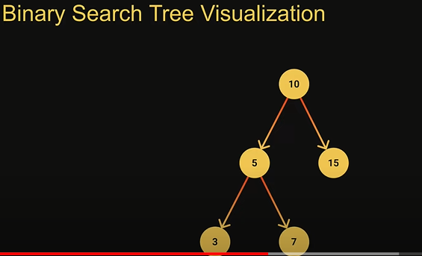
Binary Search Tree
A binary tree is a tree data structure in which each nodes has at most two children
They are refereed as left child and right child
The value of each left node must be smaller than the parent node
The value of each right node must be greater than the parent node
Binary search tree operations
Insertion – to add a node to the tree
Search – to find a node given its value
DFS & BFS – to visit all nodes in the tree
Deletion – to remove a node given its value
Binary search tree usage
Searching
To implement abstract data types such as lookup and prioritu queues

Slide 4
Trees Traversals
Visiting every node in the tree
A hierarchical data structure like a tree can be traversed in different ways
. Depth First Search – The DFS algorithm starts at the root node and explores as far as possible along each branch before backtracking.
Visit he root node, visit all the nodes the left subtree and visit all the nodes in the right subtree
Depending on the order in which we do this there can be three types of DFS
Preorder – Read the data of the node- visit the left subtree – visit the right subtree
Inorder – visit the left subtree- read the data of the node- visit the right subtree
Postorder – visit t the left subtree- visit the right subtree – read the data for the node
Breadth First Search – Explore all nodes at the present depth prior to moving on to the nodes at the next depth level
1. Create the queue
2. Enqueue the root node
3. as long as a node exists in the queue – dequeuer the node from the front – read the node’s value – enqueuer the node’s left child if it exists- enqueuer the node’s right child if it exists

